Slide 1

Department of Information Science & Engineering Secure sharing and storage of Personal Health Records in Cloud and reading current health data using Sensor Networks Under the guidance of Mrs.Padmashree.T (Asst. Professor, Dept. of ISE)
Presented By: Prachi Lakhotia-1DS10IS071
Sankalp Kak-1DS10IS080
Saurav Mawandia-1DS10IS081
Tanvee Singh-1DS10IS107

Slide 2
Introduction
Lifelong medical history of patients are maintained
Once the medical data is uploaded ,the patients and authorized doctors can access them
Advanced Encryption Standard(AES) algorithm is adapted to protect the privacy of the involved parties and their data
The system analyses various patterns in Personal Health Records such as temperature and heart beat rate and provides appropriate medical consultation

Slide 3
Problem Statement
Currently, the storage of the PHRs are not very secure and properly maintained
Online medical consultation from a group of doctors to choose from is not available
No method that stores the complete medical history of a patient at one place which is easily portable

Slide 4
Motivation
The patient need not undergo the same examination, unless strictly required for formulating a diagnosis
A patient is never able to show his entire medical history to the doctor
In recent past, storage of PHR in cloud has evolved but it also poses a serious risk on clients’ privacy
We propose a system which not only provides storage in Cloud but also protects the privacy of the involved parties and their data.

Slide 5
Objective
To provide lifelong medical history of patients
To provide secure storage of personal health records
To provide timely health advice to patients maintaining the client’s privacy

Slide 6
Existing System
Paper PHR: Easy and simple
PC-based PHR: Easy to update
Portable storage PHR :Small, portable, and very high capacity
Backups for PHR: Data should have a backup in case it gets lost or stolen
Internet storage PHR: Data should be accessible anywhere in the world in case of emergency

Slide 7
Drawbacks of the Existing System
Patient needs to visit the doctor whenever required
Carrying and maintenance of previous medical reports is cumbersome
Communication between the stake holders of the system is not secure
Day to day data like temperature, heartbeat which may require periodic analysis is not updated on a regular basis to the doctor

Slide 8
Literature Review

Slide 9
MyPHRMachines: Lifelong Personal Health Records in the Cloud [International Symposium on Digital Object Identifier: 10.1109/CBMS.2012.6266378; Van Gorp, P ; Comuzzi, M. ]
Personal Health Records (PHRs) should remain the lifelong property of patients and should be showable conveniently and securely
PHRs focus on standard data exchange formats and transformations to move data across health information systems
After uploading their medical data to MyPHRMachines,the patients, doctors and hospitals can access them
Using a web browser one can access the pre-loaded fragments of the lifelong PHR

Slide 10
CAM: Cloud-Assisted Privacy Preserving Mobile Health Monitoring [IEEE TRANASCTIONS ON IMAGE PROCESSING VOL:8 NO:6 YEAR 2013 Huang Lin, Jun Shaoy, Chi Zhangz, Yuguang Fang, Fellow, IEEE]
To design a cloud assisted privacy preserving Personal Health Records system to protect the privacy of the involved parties and their data
Advanced Encryption Standard(AES) are adapted
The system analyses various patterns in Personal Health Records such as temperature and heart beat rate and provides appropriate medical consultation

Slide 11
Scalable and Secure Sharing of Personal Health Records in Cloud Computing using Attribute-based Encryption [Issue 1;Date Jan. 2013 ;Ming Li Member, IEEE, Shucheng Yu, Member, IEEE, Yao Zheng,Student Member, IEEE, Kui Ren, Senior Member, IEEE, and Wenjing Lou,Senior Member, IEEE]
To achieve fine-grained and scalable data access control for PHRs, it uses attribute based encryption (ABE) techniques to encrypt each patient’s PHR file
Patients have full control over their own PHR data, i.e., they can create, manage and delete it.
Our scheme also enables dynamic modification of access policies or file attributes, supports efficient on-demand user/ attribute révocation

Slide 12
Secure PHR Access Control Scheme for Healthcare Application Clouds [2013 42nd International Conference on Parallel Processing Chia-Hui Liu, Fong-Qi Lin, Dai-Lun Chiang, Tzer-Long Chen, Chin-Sheng Chen, Han-Yu Lin, Yu-Fang Chung, Tzer-Shyong Chen]
PHR can integrate different kinds of personal health records
With the Internet or portable device, PHR offers the integrity and accuracy of personal health and medical records
Through electronic medical records, we can evaluate the quality of medical care, provide continued care to patients, promote the medical efficiency and increase the accuracy of medical diagnosis

Slide 13
Proposed System

Slide 14
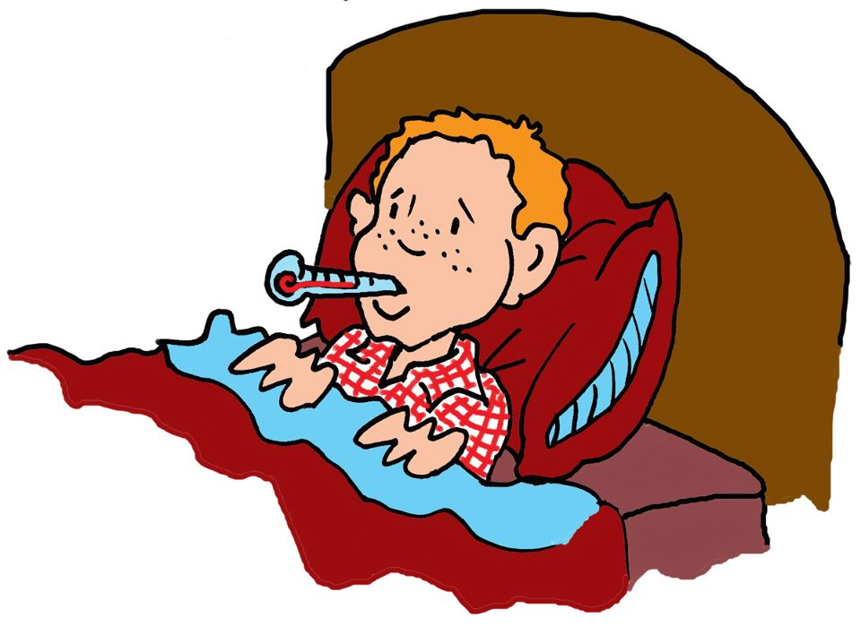
System Architecture
Temperature Sensor
Micro-controller
LCD Interface
Heartbeat Sensor
Online
Portal
Patients
Cloud Server
Doctors
Hospitals
Semi Trusted Authority

Slide 15
Stakeholders of Cloud
Semi Trusted Authority
Token generation and authorization of users
Provider
Hospital:Upload reports to a user’s profile
Doctors:Provides online consultation
User
Stores PHRs
Take advice from doctors

Slide 16
Interactions between Stakeholders
Patients take online consultation through queries
STA generates tokens which is given to the patient only when any doctor replies or the medication already exists.
Hospitals upload reports and attaches it to the respective user’s profile
5.Doctors answer to queries
6.Hospital attaches report to patient profiles
2.Writes symptoms in form of query
3.Queries are given to doctor
User:
Patient
Semi Trusted
Authority
Provider:
Doctor/Hospital
4.Issues Tokens
1.Registers

Slide 17
Hardware System
Zigbee Transmitter
Zigbee Receiver
LCD 16X2
System
IC895V51 RD2
Temperature Sensor : DS 1620
Microcontroller 8051
Heartbeat Sensor
MC 8051 LLDR

Slide 18
Software requirements
Operating System : Windows95/98/2000/XP
Application Server : Tomcat5.0/6.X
Front End : HTML, Java, JSP
Scripts : JavaScript.
Server side Script : Java Server Pages.
Database : MySql
Database Connectivity : JDBC.
Wireless Communication : Termite 2.9

Slide 19
Hardware requirements
Processor - Pentium –III
Speed - 1.1 Ghz
RAM - 256 MB (min)
Hard Disk - 20 GB
Floppy Drive - 1.44 MB
Key Board - Standard Windows Keyboard
Mouse - Two or Three Button Mouse
Monitor - SVGA
LCD - 16X2
Temperature Sensor - DS1620
Heartbeat Sensor - LDR
Microcontroller - 8051
Wireless Transmission - Zigbee Transmitter/Zigbee Receiver/Uart

Slide 20
Implementation

Slide 21
Encryption Algorithm
Plaintext
K0
Add Round Key
Sub Bytes
Shift Rows
i=1 to 10
i=10
Mix Columns
Ki
Add Round Key
Ciphertext
i<10

Slide 22
Conclusion
A novel framework of secure sharing of personal health records in cloud
Patients shall have complete control of their own privacy through encrypting their PHR files to allow fine-grained access
Patient doesn’t need to undergo the same diagnosis repeatedly
Patients can take suggestions from several doctors on the same forum

Slide 23
Future Enhancements
Portable sensors could be deployed in wireless body sensor networks to collect various physiological data, such as blood pressure (BP), breathing rate (BR), Electrocardiogram (ECG/EKG), peripheral oxygen saturation (SpO2) and blood Glucose to provide various functionalities ranging from sleep pattern analyzers, exercises, physical activity assistants, to cardiac analysis systems
Payment gateway can be added to make payments to doctor for online consultation
Latest technology can be used to wirelessly transfer data from sensors to the system
Wireless sensor network can be deployed to measure physiological data

Slide 24
References
MyPHRMachines: Lifelong Personal Health Records in the Cloud International Symposium on Digital Object Identifier: 10.1109/CBMS.2012.6266378; Van Gorp, P ; Comuzzi, M.
CAM: Cloud-Assisted Privacy Preserving Mobile Health Monitoring IEEE TRANASCTIONS ON IMAGE PROCESSING VOL:8 NO:6 YEAR 2013 Huang Lin, Jun Shaoy, Chi Zhangz, Yuguang Fang, Fellow, IEEE
Integrating Wireless Sensor Network into Cloud services for real-time data collection ICT Convergence (ICTC), 2013 International Conference; Piyare, R. ; Dept. of Inf. Electron. Eng., Mokpo Nat. Univ., Mokpo, South Korea ; Sun Park ; Se Yeong Maeng;Sang Hyeok Park
Scalable and Secure Sharing of Personal Health Records in Cloud Computing using Attribute-based Encryption Issue 1;Date Jan. 2013 ;Ming Li Member, IEEE, Shucheng Yu, Member, IEEE, Yao Zheng,Student Member, IEEE, Kui Ren, Senior Member, IEEE, and Wenjing Lou,Senior Member, IEEE
Secure PHR Access Control Scheme for Healthcare Application Clouds 2013 42nd International Conference on Parallel Processing Chia-Hui Liu, Fong-Qi Lin, Dai-Lun Chiang, Tzer-Long Chen, Chin-Sheng Chen, Han-Yu Lin, Yu-Fang Chung, Tzer-Shyong Chen
Novel Cloud and SOA-Based Framework for E-Health Monitoring Using Wireless Biosensors IEEE Journal of Biomedical and Health Informatics, Vol. 18, No. 1, January 2014; Abdelghani Benharref and Mohamed Adel Serhani

Slide 25
Thank You

